Slide 1
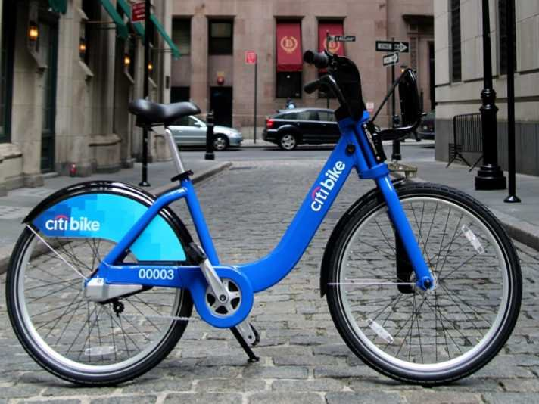
Citi Bike NYC
Letting you ride bikes
from whatever station to whatever station
since July 2013

Slide 2
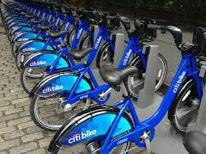
Citi Bike Background
Citi Bike stocks hundreds of stations with bicycles.
Annual subscribers and short-term customers borrow bikes from any station and return them to any station.
This adds up to tens of thousands of rides per day.

Slide 3
Citi Bike Data
Citi Bike has made available data describing every ride taken from July 2013 to February 2014.
This data includes the time and station of departure and arrival (as well as some other variables).

Slide 4
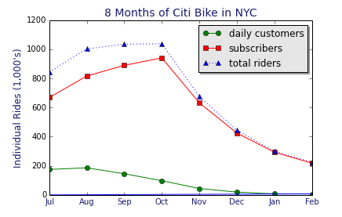

Slide 5
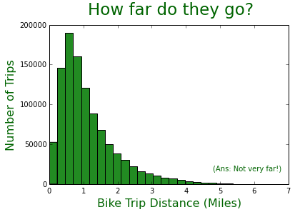
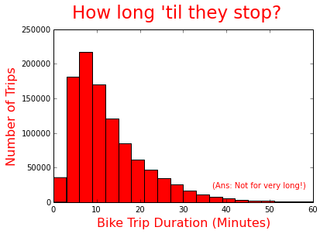
October 2013: Trips are short (as the crow flies)

Slide 6
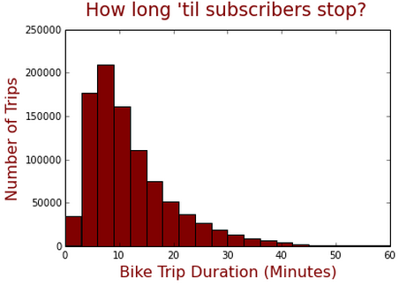
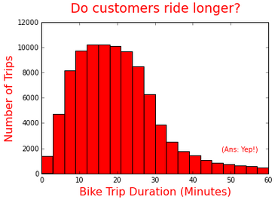
October 2013:
Subscribers know when to say when.
19.1%
0.7%
Mean = 12m, 33s
Mean = 25m, 31s

Slide 7

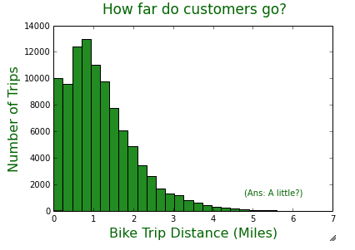
October 2013:
Short-Term Customers Bike Slightly Farther
Mean = 1.11 miles
Mean = 1.18 miles

Slide 8
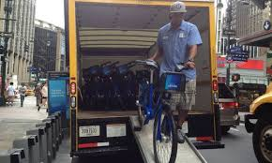
Citi Bike Background: An Inventory Issue
Since there is no control over who brings bikes where, riders tend to move bikes away from where they want them to be.
Riders also fill up docks where they want to stop.
Citi Bike is “‘experimenting with using bike trailers for rebalancing’ — moving bikes from stations with no empty slots to docks in other areas.”*
*http://www.nydailynews.com/new-york/citi-bike-issues-linger-article-1.1832298

Slide 9
Citi Bike Data Analysis: Goals
To describe & visualize the balancing of bicycle movements across the system in a meaningful and intuitive manner.
To illustrate and differentiate bike movements in specific stations.
To generate insight into how Citi Bike can go about rebalancing stations.

Slide 10
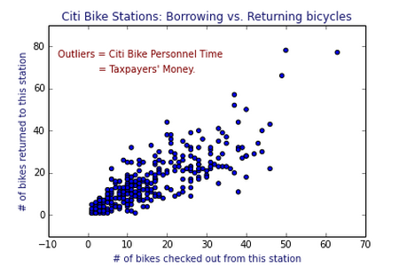

Slide 11
Citi Bike Ride Imbalances: July 2013 to February 2014
Green = More going (departures)
Red = More stopping (arrivals)
Beige = Not much difference either way

Slide 12
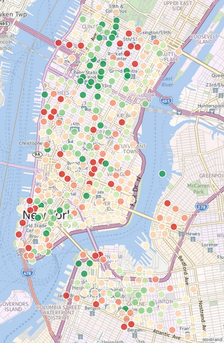
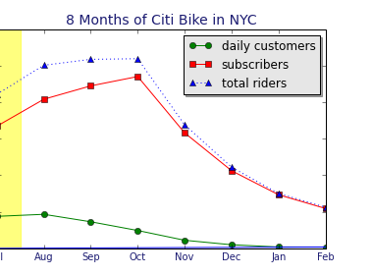
July
~850,000
rides

Slide 13
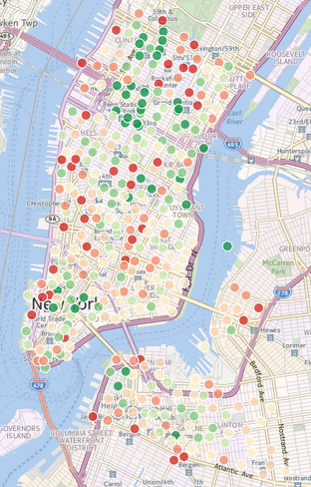
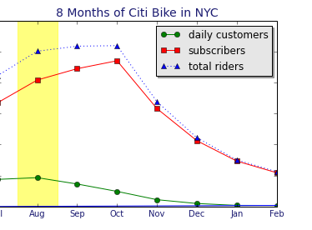
August
>1 million
rides

Slide 14
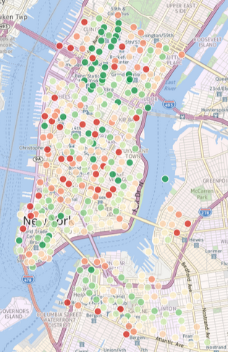
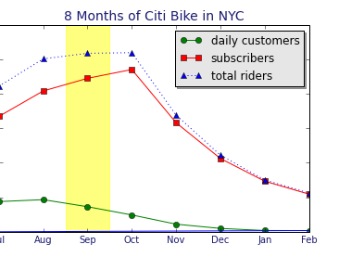
September
>1 million
rides

Slide 15
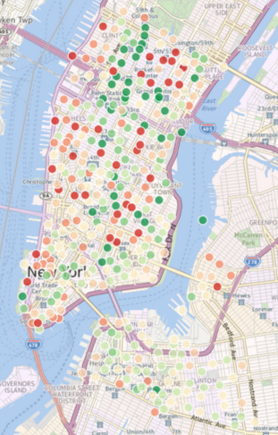
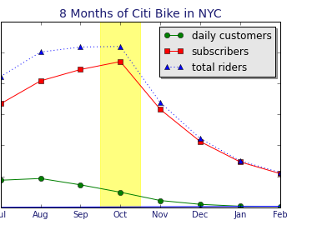
October
>1 million
rides

Slide 16
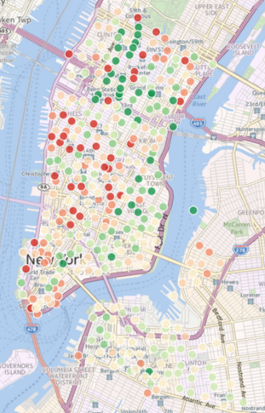
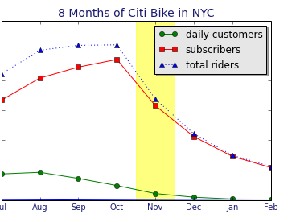
November
>1 million
rides

Slide 17
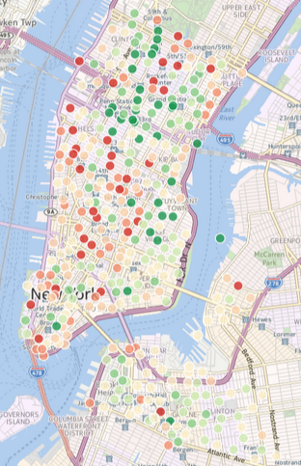
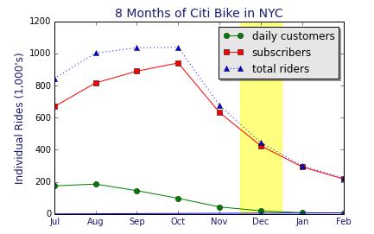
December
>1 million
rides

Slide 18
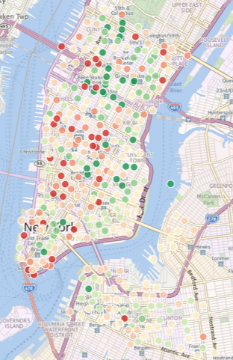
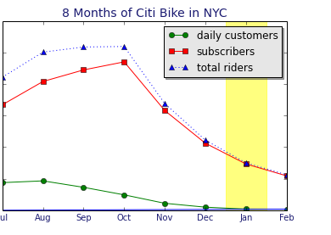
January
>1 million
rides

Slide 19
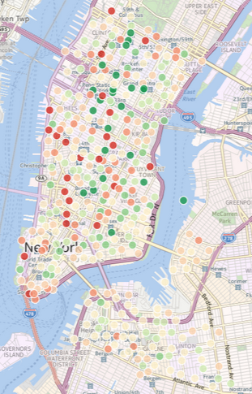
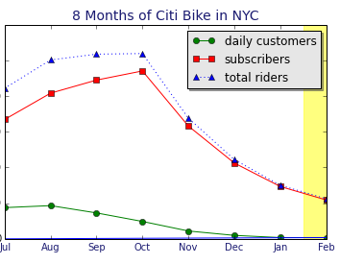
February
>1 million
rides

Slide 20
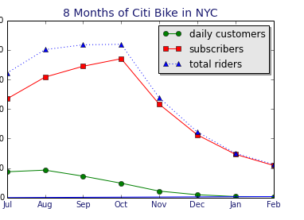
Total
>5 million
rides

Slide 21
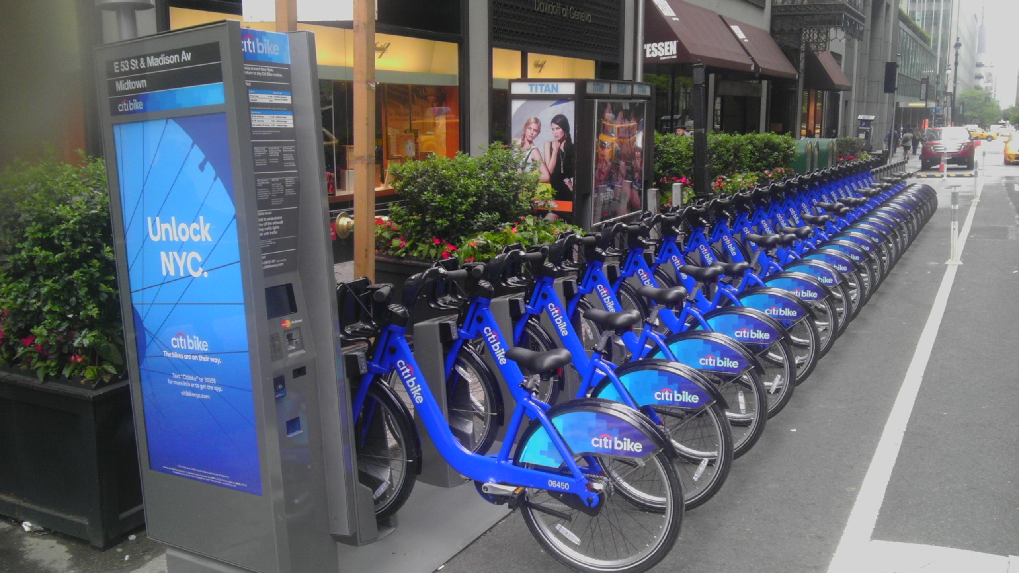
Mapping Traffic at Individual Bike Stations:
Challenges
How to process millions of lines of data?
Even processing a month (or even two weeks) at a time eventually crashes the iPython Notebook.
How to understand & visualize station traffic?

Slide 22
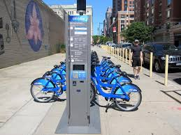
Mapping Traffic at Individual Bike Stations:
Solutions
Processing:
Process “big csv files” piecemeal.
Generate summary matrices.
Export to csv.
Interrupt. Reload. Repeat.
Visualizing station traffic:
Summarize big picture in broad strokes (as shown).
Average the details on a weekly schedule.

Slide 23
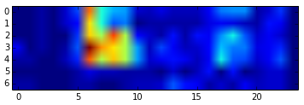
Initial Visualization:
Bikes going from station 492 by hour of week
plt.imshow(np.transpose(start492frame))

Slide 24
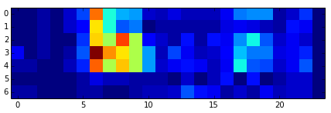
Initial Visualization:
Bikes going from station 492 by hour of week
plt.imshow(np.transpose(start492frame))
plt.imshow(np.transpose(start492frame), interpolation="nearest")

Slide 25
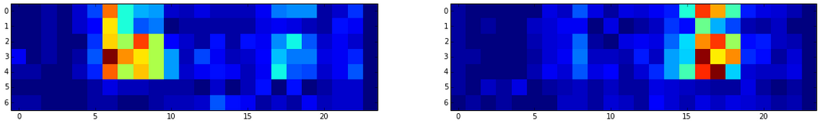
Color representation
of comings and goings
ax[0,0].imshow(sm492, interpolation='nearest')
ax[0,1].imshow(em492, interpolation='nearest')

Slide 26
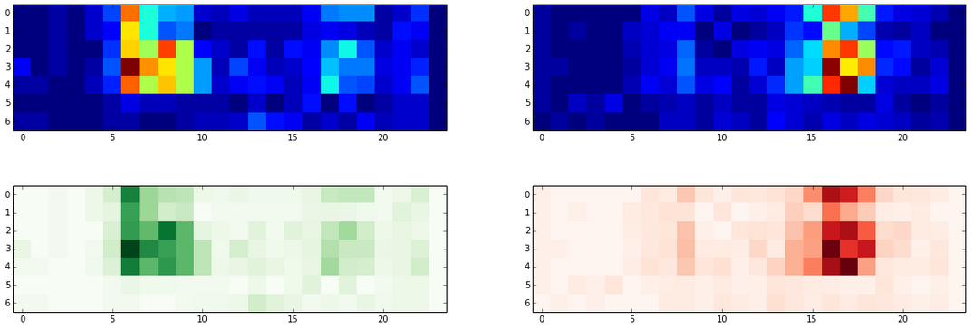
Color representation
of comings and goings
ax[0,0].imshow(sm492, interpolation='nearest')
ax[0,1].imshow(em492, interpolation='nearest')
Going from (cmap=‘Greens’)
Stopping at (cmap=‘Reds’)

Slide 27
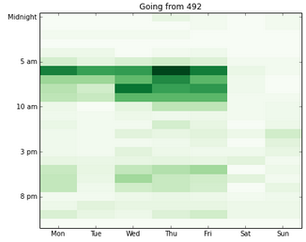
Station 492 departures by hour of week

Slide 28
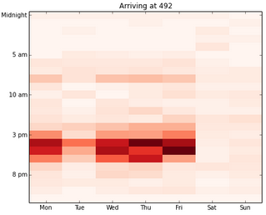
Station 492 arrivals by hour of week

Slide 29
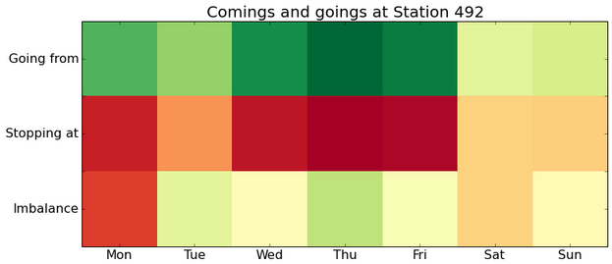
Weekly Summary (using cmap=‘RdYlGn’)

Slide 30
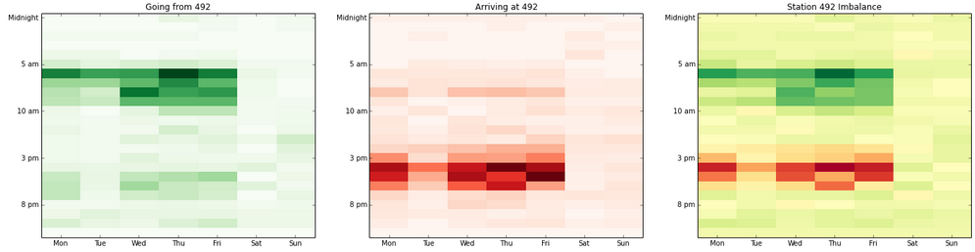
Station 492 Summary
w/adjusted aspect ratio & labelling

Slide 31

Color Mapping Issues
Color maps scale to the entered data!
(0, 0, 1) = (0, 0, 10,000,000)
(0, 100, 200) = (432, 434, 436)
Max & min always depicted as extreme values.
Comparing colors between (& maybe within) graphs is virtually meaningless!
Red-Yellow-Green is not easy to interpret.
(See beige background.)

Slide 32
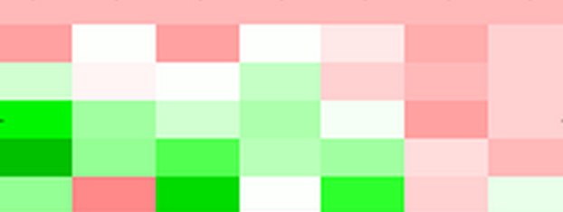
Color Mapping Solutions
Build my own red and green color maps.
LinearSegmentedColormaps
Write function to alter colormap according to data range.
(0, 0, 1) != (1, 1, 2) != (2, 2, 3)
Since rescaling the data has no effect, rescale the scale.
Create Red-White-Green.

Slide 33
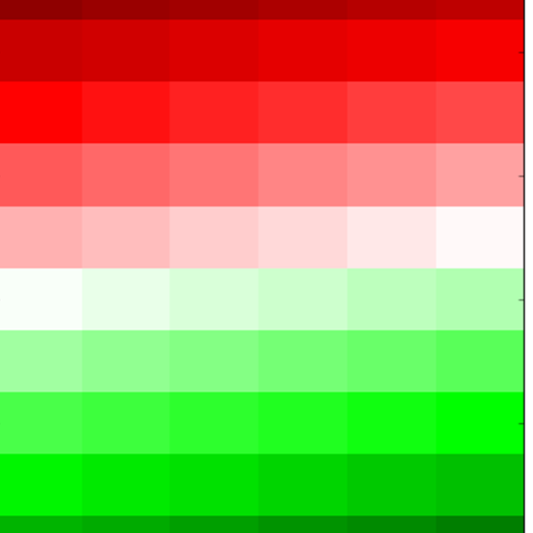
Coding Color Maps
“Red-White-Green”
cdictGR= {'red': ((0.0, 0.35, 0.35),
(0.25, 1.0, 1.0),
(0.5, 1.0, 1.0),
(0.75, 0.0, 0.0),
(1.0, 0.0, 0.0)),
'green': ((0.0, 0.0, 0.0),
(0.25, 0.0, 0.0),
(0.5, 1.0, 1.0),
(0.75, 1.0, 1.0),
(1.0, 0.25, 0.25)),
'blue': ((0.0, 0.0,0.0),
(0.25, 0.0, 0.0),
(0.5, 1.0, 1.0),
(0.75, 0.0, 0.0),
(1.0, 0.0, 0.0))}
Unicolor with variables
{'red': ((0.0, Crv[0], Crv[0]),
(Cset2, Crv[1], Crv[1]),
(1.0, Crv[2], Crv[2])),
'green':((0.0, Cgv[0], Cgv[0]),
(Cset2, Cgv[1], Cgv[1]),
(1.0, Cgv[2], Cgv[2])),
'blue': ((0.0, Cbv[0], Cbv[0]),
(Cset2, Cbv[1], Cbv[1]),
(1.0, Cbv[2], Cbv[2]))}

Slide 34
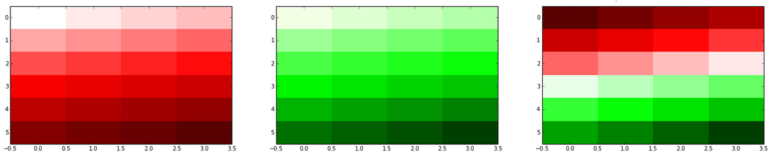
New color maps

Slide 35
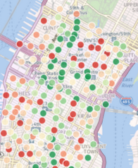
New Color Maps: Station 519 vs. Station 119
Station 2021 is on W. 45th at 8th Ave.
Station 519 is right outside Grand Central Station.
2021
519

Slide 36
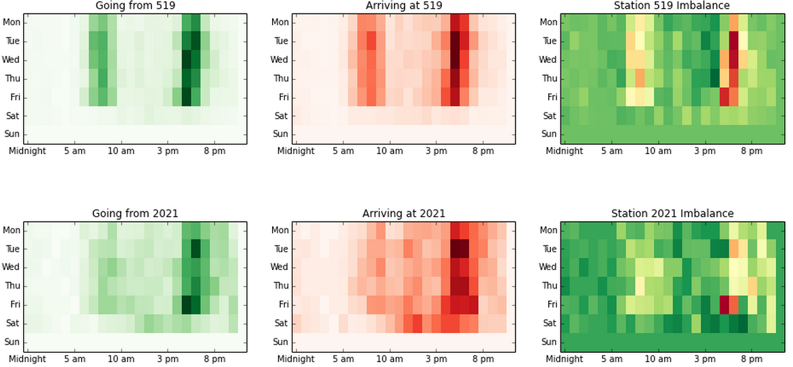
Summary report of 519 & 2021: Before

Slide 37
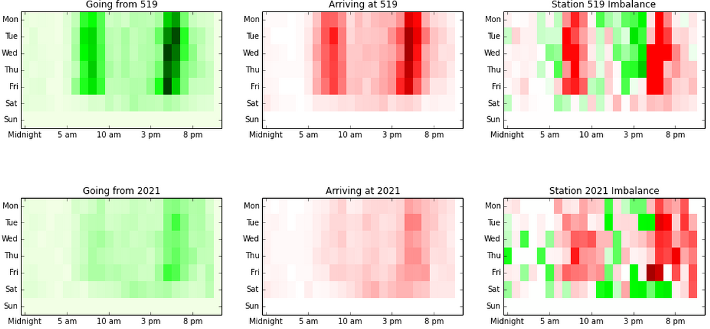
After: Optionally Scaled Contextually

Slide 38

Future Directions
Short-term riders: Analyze differences between short-term customers (mo’ $$$) and long-term subscribers to see if rebalancing can increase rentals.*
Color mapping: Complete automation of bi-directional colorbar & update color mapping programs to accurately depict a wider range of possibilities.*
Station Dictionary: Populate dictionary with station ID’s & count matrices to automate more of the data processing & storage processes.
Cluster analysis: Use cluster analysis to group stations by weekly movements (and possibly location).
Practical applications: Use these techniques to identify and respond to specific questions Citi Bike might have.
*Already started on this one.

Slide 39
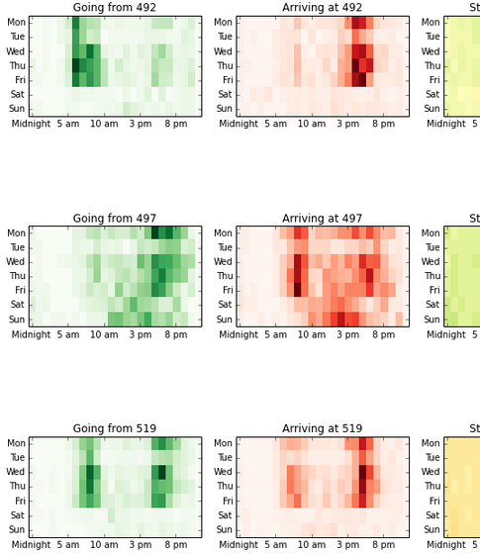
Color-Coded Station Summaries (3rd look)

Slide 40
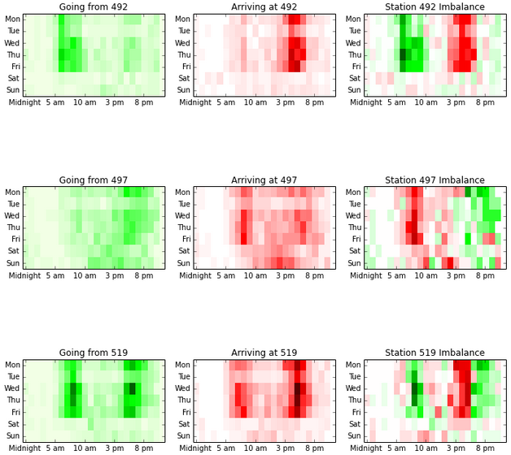
Color-Coded Station Summaries (3rd look)

Slide 41
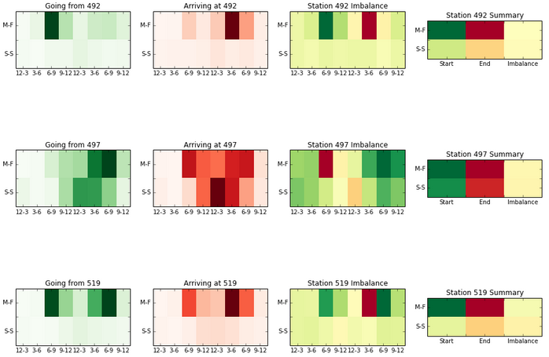
Color-Coded Station Summaries (1st look)

Slide 42
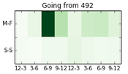
Weekday/Weekend by 3-hour slots

Slide 43
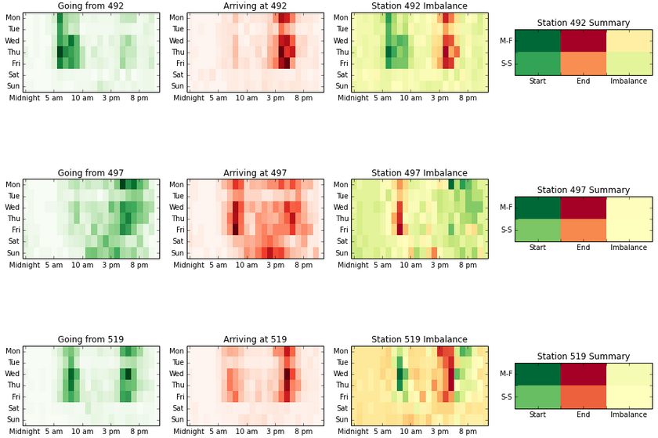
Color-Coded Station Summaries (2nd look)

Slide 44
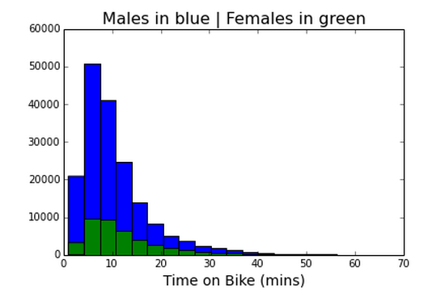
Time on Bike by Gender

Slide 45
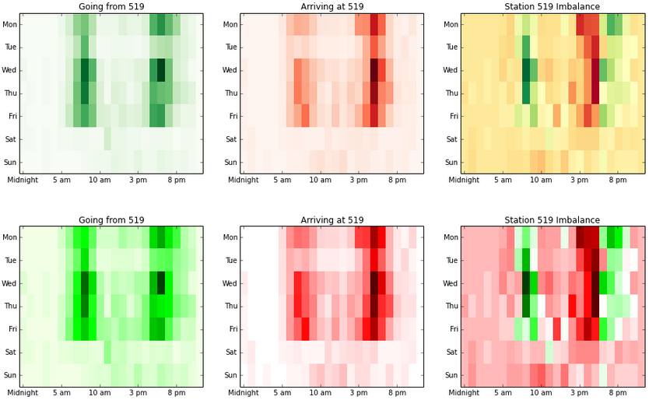
New Color Maps: Before and after

